Slide 1
Part 2:Introduction to R and Rstudio
T. Mayooran,
Department of Interdisciplinary Studies,
Faculty of Engineering,
University of Jaffna.
Email: mayooran@eng.jfn.ac.lk

Slide 2
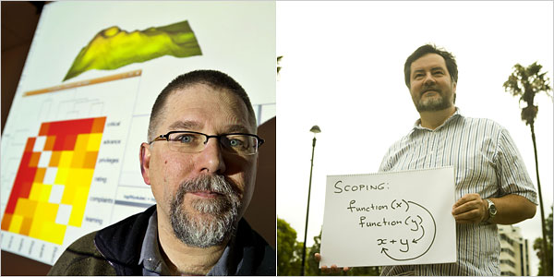
R: background
First created in the early 1990s by Ross Ihaka and Robert Gentleman as an implementation of S.
Development soon shifted to a larger core group.
Distributed under the GNU General Public License.

Slide 3
R ?
Why

Slide 4
R: Why should I use it?
It’s open source and free. (R vs. SAS)
It has a large body of academic users. Most statistical tests will have some implementation in R.
It is a full-blown programming language. (R vs. SPSS)
It's free.

Slide 5

Statistics
Machine Learning
Network Analysis
Text Analysis
Dynamic Reports
GIS

Slide 6
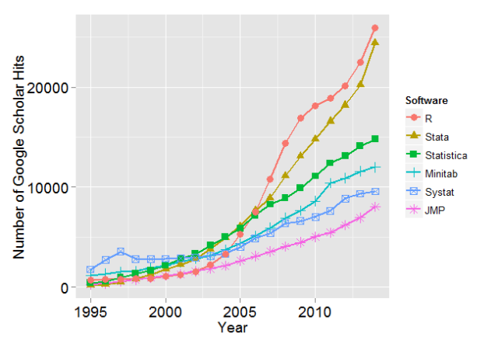
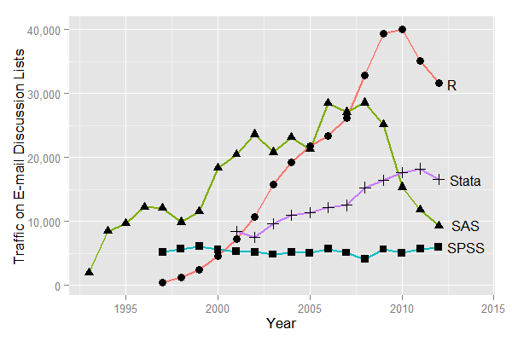
R is growing
http://r4stats.com/articles/popularity/

Slide 7
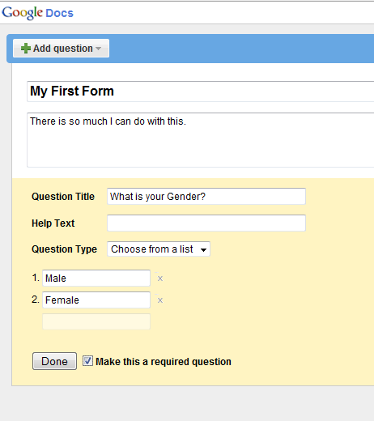
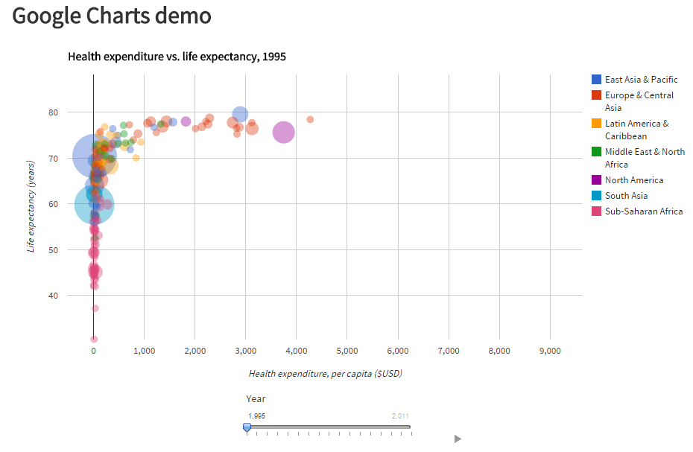
API
Shiny

Slide 8
R and RStudio: Installation and Start
Since R and RStudio are free, you should install them on your computer. R: Google it using R or CRAN (Comprehensive R Archive Network)
RStudio : Google it using RStudio
Download link https://www.r-project.org/
https://posit.co/download/rstudio-desktop/
Please check our Part 1 Slide!

Slide 9
R: Installation and Start
Most R users also use an integrated development environment (IDE) for coding in R. RStudio is the most popular one.
If you haven't already, please install RStudio on your PC.

Slide 10
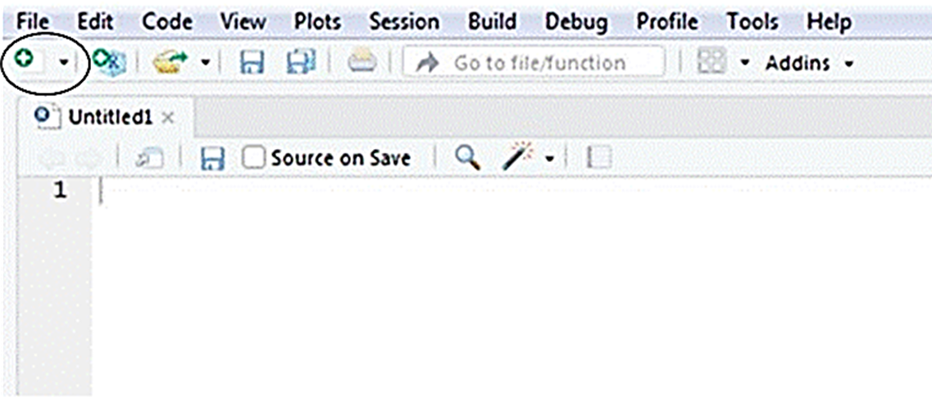
Using RStudio
To get started, open RStudio like you would any other software.
You should see three windows.
Open a fourth window by clicking File => New File => RScript.
Alternatively, you can click the green and white plus sign/blank document icon => RScript.

Slide 11
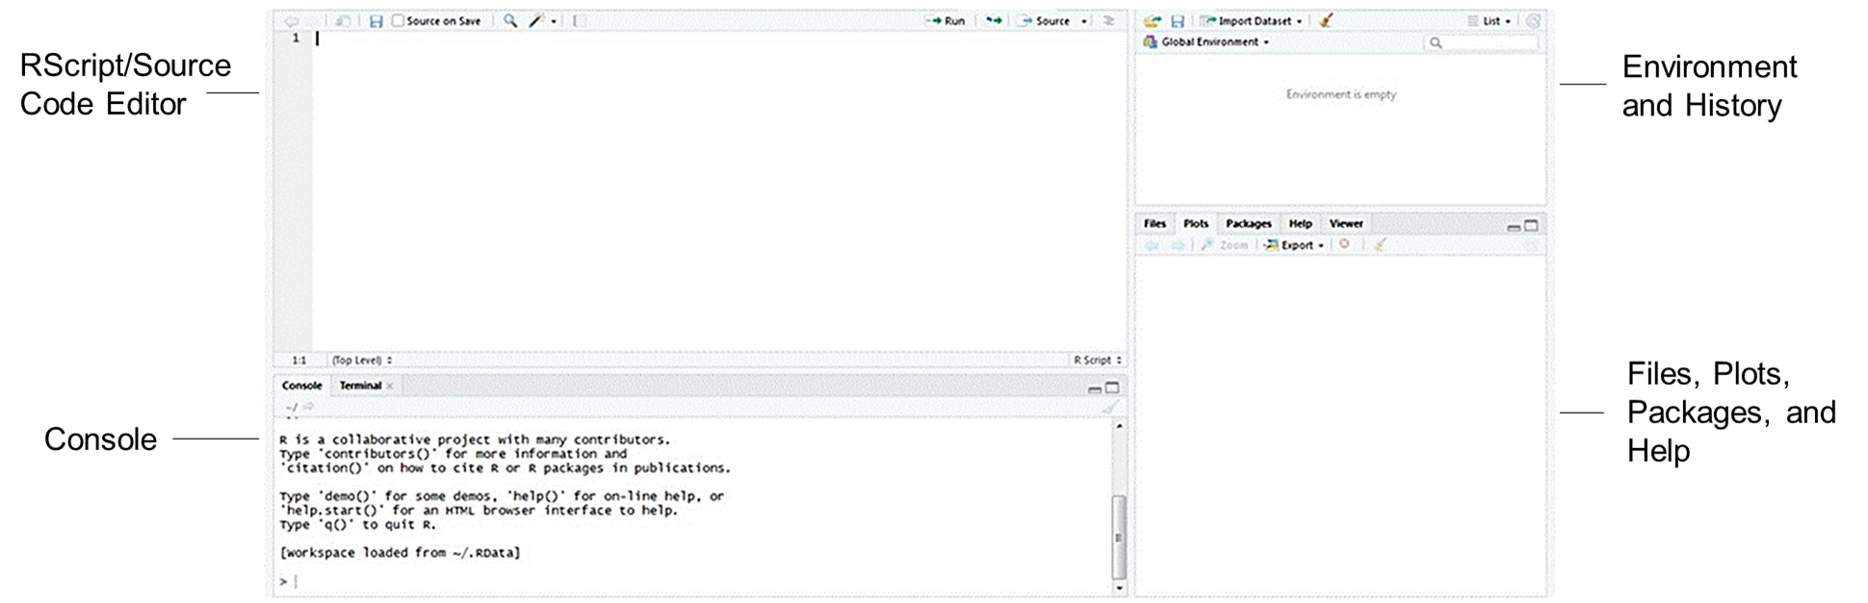
The four windows in RStudio

Slide 12
Description of the RStudio windows
RScript/Source Code Editor – the top left window – is a text editor where you can save your code.
Console – the bottom left window – sends the code to R to execute your commands.
Environment and History – the top right window – view a list of the objects available in your current R session (e.g. data sets, variables, matrices, etc.)
Files, Plots, Packages, and Help – the bottom right window – manage files, view plots, install packages, and access the help menu.

Slide 13
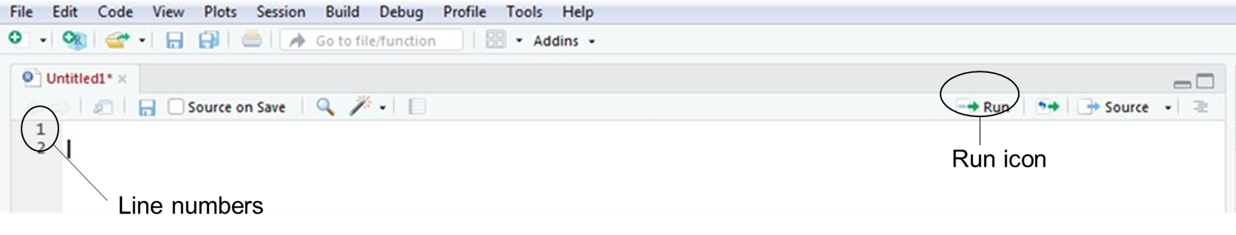
Using RScript
The lines of code in the RScript are numbered to help you stay organized and find errors more easily. Write your code and put your cursor on the line of code you want to run. Send it to the console which runs it in R by clicking on the “Run” icon or by typing “Ctrl + Enter”. Note if you want to run multiple lines of code at the same time, highlight them all and then send them to the console.
Code can be saved in the RScript as a .R file to be rerun or modified at another point in time.

Slide 14
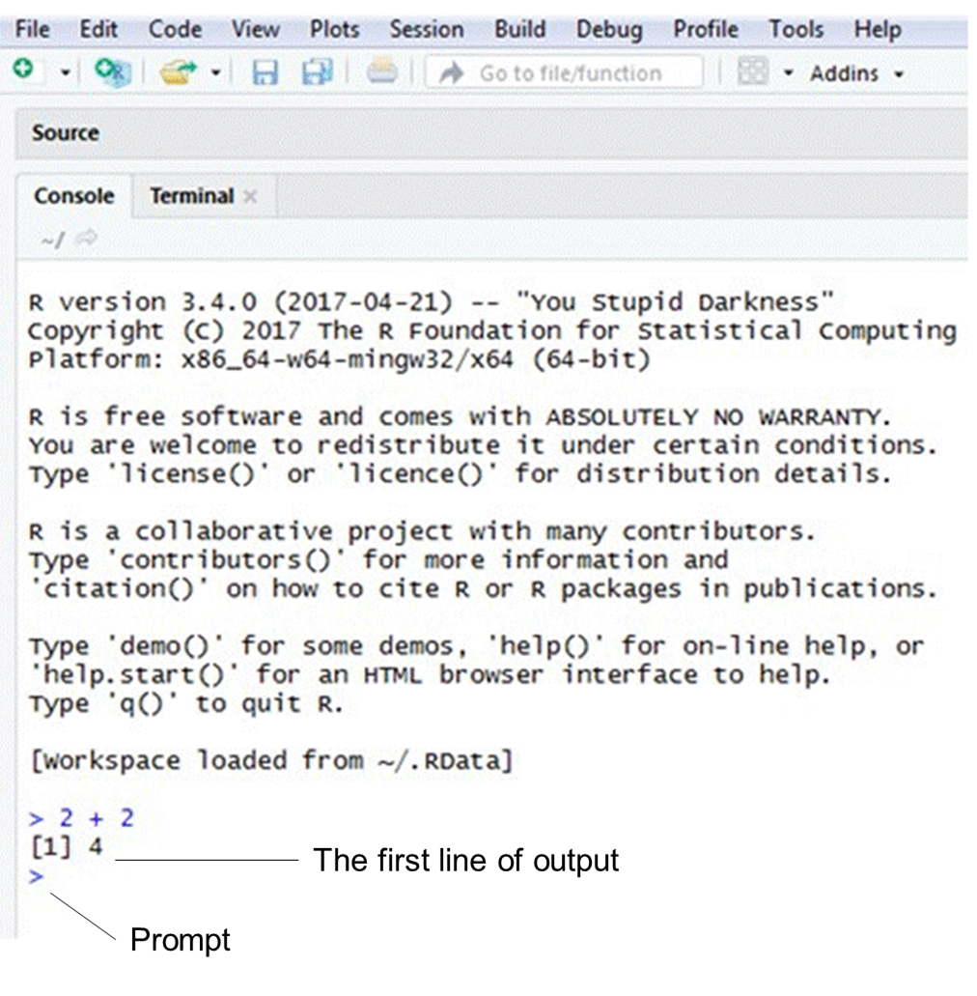
Using the console
If you click in the console, you should see a blinking cursor line (“|”) next to a greater than sign (“>”). This is called a prompt. You can write code next to the prompt and then press the “Enter” key to send the code to R.
The console displays any mistakes in your code (i.e. this is where you will receive error messages). In addition, the console shows your output (i.e. the results of your code) beside square brackets.
Note that any code written in the console will not be saved if you close RStudio. If you want to save the code, write it in RScript and then send it to the console.

Slide 15
R: some useful tidbits
The question mark will display a function’s help text. This is a shortcut for the help() function ? sin
The up arrow key will go back to previous commands
The hashtag is used for comments #This is an R comment
The command system() is used for shell commands system("rm core")
The rm() command clears variables rm(list=ls(all=TRUE)) #Clear all variables

Slide 16
R: Packages
An R package refers to a collection of previously programmed functions, often including functions for specific tasks.
R currently has thousands of packages.
Most packages are easy to install and are often well documented.
Decent packages include sample data, supporting statistical theory, and a list of examples using each of the functions they contain.
Good packages will maintain some sort of mailing list or message board for feedback.

Slide 17
R: Installing Packages
From the command line install.packages(“grabsampling") This goes to CRAN, looks for a package called “grabsampling”, and downloads it to your computer. This only saves the files to your machine. To use the package in an R session library(grabsampling)

Slide 18
R: Installing Packages
Some useful packages are not on CRAN. Installing these can be a hodgepodge
# install.packages("devtools")
library(devtools)
install_github("Mayooran1987/grabsampling")

Slide 19
Common Errors!
R will not execute a command if it is written incorrectly. If you have a mistake in your code, an error message will show up in the console.
Some of the most common errors occur due to the following:
Inconsistent capitalization and spelling or incorrect punctuation
Parentheses or brackets that have not been closed

Slide 20
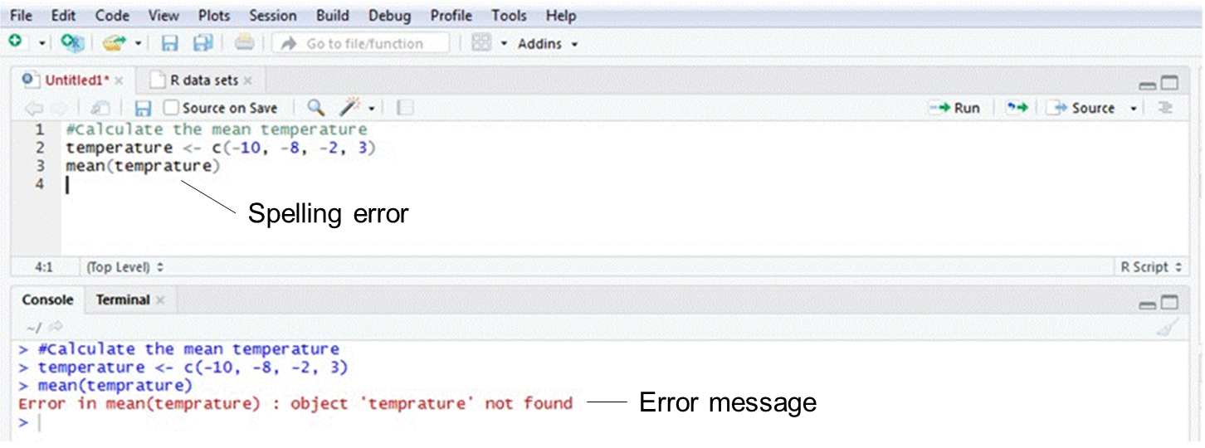
Capitalization, spelling, and punctuation
Use the same capitalization and spelling throughout your code.
Ensure you punctuation is correct. Commas separate components of the code so it is important to make sure they are in the right spot.

Slide 21
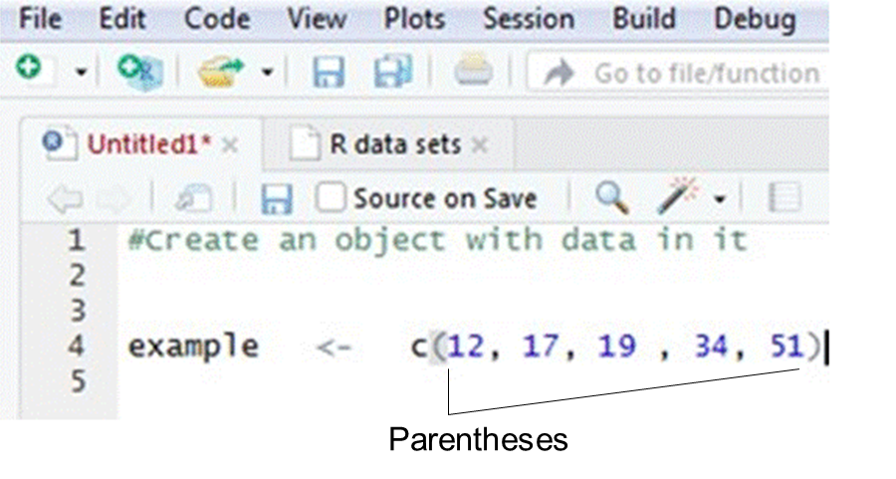
Brackets and parentheses
Make sure all your parentheses and brackets open and close (i.e. they should face forward and backward).
Example
( ) or [ ] or { }
Note: Parentheses, square brackets, and curly brackets mean different things and are not interchangeable. Most of the time you will use parentheses ( ).
In the RScript, corresponding parentheses and brackets will be highlighted in grey.

Slide 22
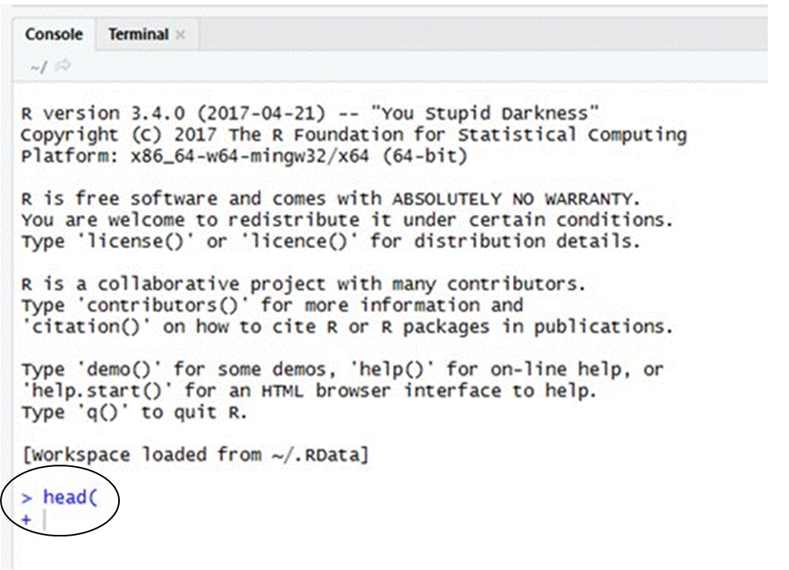
A plus sign (“+”) in the console
If the console displays a plus sign (“+”) it means something is missing (e.g. usually you have forgotten to close your parentheses) and R is waiting for you to add it.
Press the escape key (“Esc”) and then “Enter” to get back to the prompt (“>”).

Slide 23
R: Creating variables
We will spend the next few slides building up the ornithological data set below.

Slide 24
R: Creating variables
The left arrow operator assigns values to variables. a <- 59 b <- 55 c <- 53.5
The equal sign can also be used for assignments. a = 59
After doing this in R, a has a value of 59 a [1] 59 a == 59 [1] TRUE

Slide 25
R: Creating variables
Generally, you will have a more joyful life if you have variables that have some meaning Wing1 <- 59 Wing2 <- 55 Wing3 <- 53.5 Wing4 <- 55 Wing5 <- 52.5

Slide 26
R: Creating variables
We can, of course, do arithmetic operations on these variable names sqrt(Wing1) [1] 7.681146 (Wing1 + Wing2 + Wing3 + Wing4 + Wing5)/5 [1] 55
Or store the results in other variables SQ.Wing1 <- sqrt(Wing1) Mean.Wing <- (Wing1 + Wing2 + Wing3 + Wing4 + Wing5)/5

Slide 27
R: Creating variables
It's kind of weird to store the data about Wing lengths in five separate variables.
It would be more natural to store the data in a 5-tuple or vector of length five.
We can use the c() function to combine numbers (or vectors) into a vector of data Wingcrd <- c(59, 55, 53.5, 55, 52.5, 57.5, 53, 55)

Slide 28
R: Creating variables
We can access values in the vector by indexing with brackets. Wingcrd[1] [1] 59 Wingcrd[3] [1] 53.5 Wingcrd[1:3] [1] 59.0 55.0 53.5 Wingcrd[-2] [1] 59.0 53.5 55.0 52.5 57.5 53.0 55.0 sum(Wingcrd) [1] 440.5

Slide 29
R: Creating variables
We finish off the other columns Tarsus <- c(22.3, 19.7, 20.8, 20.3, 20.8, 21.5, 20.6, 21.5) Head <- c(31.2, 30.4, 30.6, 30.3, 30.3, 30.8, 32.5, NA) Wt <- c(9.5, 13.8, 14.8, 15.2, 15.5, 15.6, 15.6, 15.7)

Slide 30
R: Creating variables
Note the missing value in Head cascades through other calculations sum(Head) [1] NA
We can work around this if we want to sum(Head, na.rm = TRUE) [1] 216.1

Slide 31
R: Creating variables
To assemble the data together we can bind our vectors coulmn-wise with cbind() BirdData <- cbind(Wingcrd, Tarsus, Head, Wt) BirdData Wingcrd Tarsus Head Wt [1,] 59.0 22.3 31.2 9.5 [2,] 55.0 19.7 30.4 13.8 [3,] 53.5 20.8 30.6 14.8 [4,] 55.0 20.3 30.3 15.2 [5,] 52.5 20.8 30.3 15.5 [6,] 57.5 21.5 30.8 15.6 [7,] 53.0 20.6 32.5 15.6 [8,] 55.0 21.5 NA 15.7

Slide 32
R: Creating variables
We can pick out values by specifying rows and columns BirdData[1, 2] Tarsus 22.3 BirdData[1, 2:4] Tarsus Head Wt 22.3 31.2 9.5 BirdData[, 3] [1] 31.2 30.4 30.6 30.3 30.3 30.8 32.5 NA BirdData[1, c(2, 3)] Tarsus Head 22.3 31.2

Slide 33
R: Importing Data
Most data sets will be created outside of R and imported. We create a csv file to import by writing the data to the disk getwd() [1] "/Users/ranalytics" write.table(BirdData, "BirdData.csv", sep=",")

Slide 34
R: Importing Data
Now to import. BirdDF <- read.csv("BirdData.csv", header=TRUE)
While the data we wrote to the disk was a matrix when R reads the csv file it defaults a dataframe—R's preferred datatype.
Now the column names give you access to the data. BirdDF$Wingcrd [1] 59.0 55.0 53.5 55.0 52.5 57.5 53.0 55.0

Slide 35
R: Importing Data
Acessing entries still works the same BirdDF[1,2] [1] 22.3 BirdDF[1,2:4] Tarsus Head Wt1 22.3 31.2 9.5 BirdDF[, 3] [1] 31.2 30.4 30.6 30.3 30.3 30.8 32.5 NA BirdDF[1, c(2, 3)] Tarsus Head1 22.3 31.2

Slide 36
R: Importing Data
However, matrix operations won't work on the dataframe data BirdDF %*% t(BirdDF) Error in BirdDF %*% t(BirdDF) : requires numeric/complex matrix/vector arguments
Casting from from datatype to the other is easy as.matrix(BirdDF) as.data.frame(BirdData)

Slide 37
R: Plotting Data
The most basic plotting command in R is plot()
As a high-level function it will create axes, tick marks, etc .
Many user-written classes will have default plot() functions that act reasonably

Slide 38
R: Plotting Data
We'll explore this with a dataset of car speeds and stopping distances from the 1920s in R as cars (Ezekiel, M. (1930) Methods of Correlation Analysis. Wiley. ) head(cars) speed dist 1 4 2 2 4 10 3 7 4 4 7 22 5 8 16 6 9 10

Slide 39
R: Plotting Data
By default plot() produces a scatterplot plot(cars)
Axis labels are from the names in the data frame
Axis scale is from the range of the data

Slide 40
R: Plotting Data
plot(cars$speed, cars$dist, main = "A Title", xlab = "The Speeds", ylab = "The Distances", col="steel blue")

Slide 41
R: Plotting Data
Each plot() call creates its own axes, labels, etc
Combining plot() calls can be messy plot(cars) par(new=TRUE) plot((lowess(cars), type="l", col="red"))
The graphs labels are clearly bad. While not obvious, the scales don’t match either.

Slide 42
R: Plotting Data
To add details it’s better to use so-called low-level functions. plot(cars) line(lowess(cars), col="red")

Slide 43
R: Plotting Data
To show multiple plots in one graphics window use the par() command with the mfrow parameter par(mfrow=c(2, 2)) plot(cars, type="p") plot(cars, type="l") plot(cars, type="h") plot(cars, type="s")

Slide 44
R: Plotting Data
The default plot type for a dataframe is a scatterplot plot(BirdDF)

Slide 45
R: Plotting Data
For dataframes with lots of data scatterplots can be a bit much plot(mtcars)

Slide 46
R: Plotting Data
If you are working in batch, you can have plot write to a file. png(filename = "mess.png") plot(mtcars) dev.off()

Slide 47
R: Plotting Data
For more fine-tuned control of graphics consider the lattice ggplot2 packages.
They probably deserve a talk on their own.

Slide 48
R: Analyzing data
Common statistical tests are very straightforward in R. How about a t-test that the mean of the speeds in cars is not 12? t.test(cars$speed, mu=12) One Sample t-test data: cars$speed t = 4.5468, df = 49, p-value = 3.588e-05 alternative hypothesis: true mean is not equal to 12 95 percent confidence interval: 13.89727 16.90273 sample estimates: mean of x 15.4

Slide 49
R: Analyzing data
We can change the parameters of t-test. t.test(cars$speed, mu=12, alternative="less", conf.level=.99) One Sample t-test data: cars$speed t = 4.5468, df = 49, p-value = 1 alternative hypothesis: true mean is less than 12 99 percent confidence interval: -Inf 17.19834 sample estimates: mean of x 15.4

Slide 50
R: Analyzing data
Regression analysis is one of the most popular and important tools in statistics. If R goofed here, it would be worthless.
R uses the function lm() for linear models.
Generic syntax lm(DV ~ IV1, NAME_OF_DATAFRAME)
The above tells R that to regress the dependent variable (DV) onto independent variable IV1. We can include other variables and interaction effects. lm(DV ~ IV1 + IV2 + IV1*IV2, NAME_OF_DATAFRAME)

Slide 51
R: Analyzing data
Let's do an example using the 1920s cars data set. How about regressing stopping distance on speed. lm(dist ~ speed, cars) Call:lm(formula = dist ~ speed, data = cars) Coefficients: (Intercept) speed -17.579 3.932
To work more let's store this in a variable car.fit <- lm(dist ~ speed, cars)

Slide 52
R: Analyzing data
summary(car.fit) Call: lm(formula = dist ~ speed, data = cars) Residuals: Min 1Q Median 3Q Max -29.069 -9.525 -2.272 9.215 43.201 Coefficients: Estimate Std. Error t value Pr(>|t|) (Intercept) -17.5791 6.7584 -2.601 0.0123 * speed 3.9324 0.4155 9.464 1.49e-12 ***

Slide 53
R: Analyzing data
We can also look at individual fields of the lm object. car.fit$coefficients (Intercept) speed -17.579095 3.932409 car.fit$residuals[1:3] 1 2 3 3.849460 11.849460 -5.947766 car.fit$fitted.values[1:3] 1 2 3 -1.849460 -1.849460 9.947766

Slide 54
R: Analyzing data
Plot the fit plot(cars$speed, cars$dist, xlab="distance", ylab="speed") abline(car.fit, col="red")

Slide 55
R: Analyzing data
Class lm object have their own overloaded plot() function plot(car.fit)

Slide 56
R: Analyzing data
Class lm object have their own overloaded plot() function plot(car.fit)

Slide 57
R: Analyzing data
Class lm object have their own overloaded plot() function plot(car.fit)

Slide 58
R: Analyzing data
Class lm object have their own overloaded plot() function plot(car.fit)

Slide 59
R- Output for selected questions in Lect_5 slide Following slides prepared by: Miss M. Mathangi and Miss M. Rogetha

Slide 60
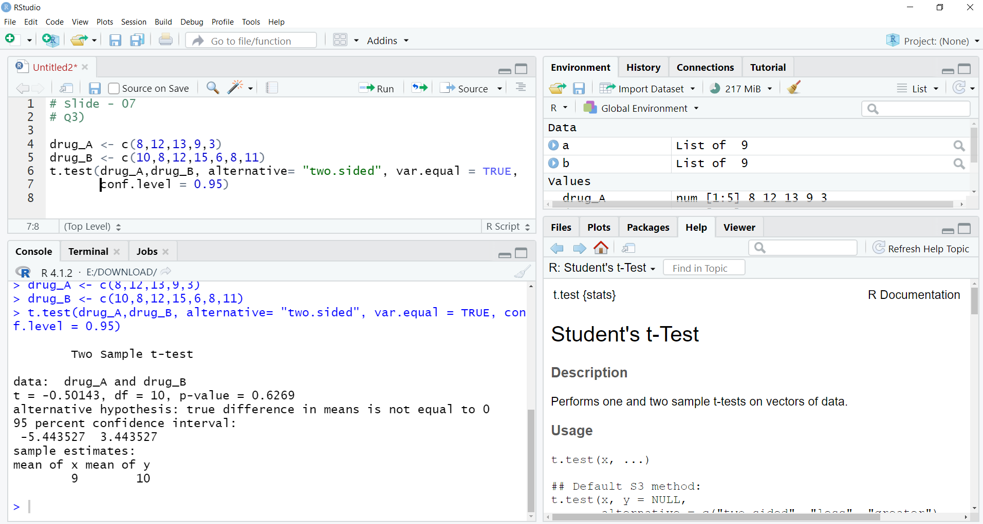
Slide No – 21 Question - 3

Slide 61
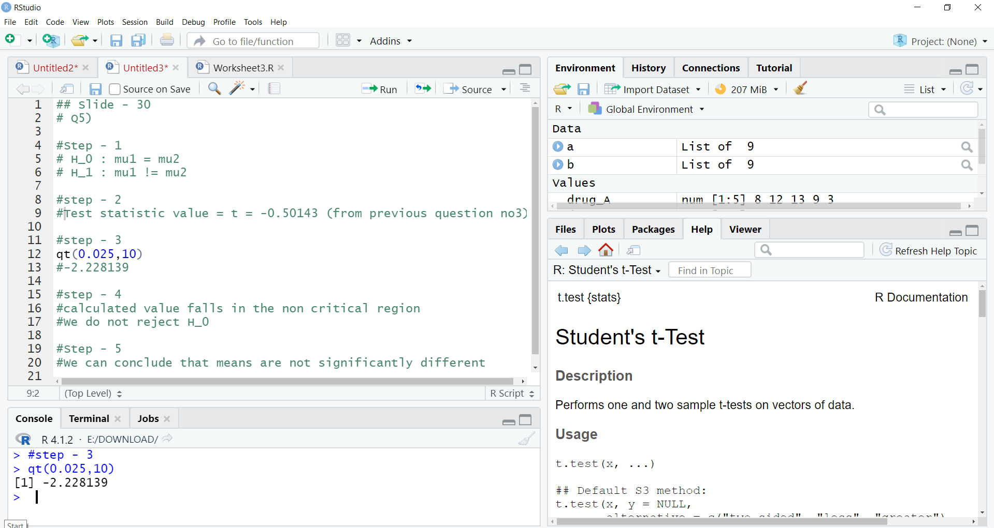
Slide No – 30 Question - 5

Slide 62
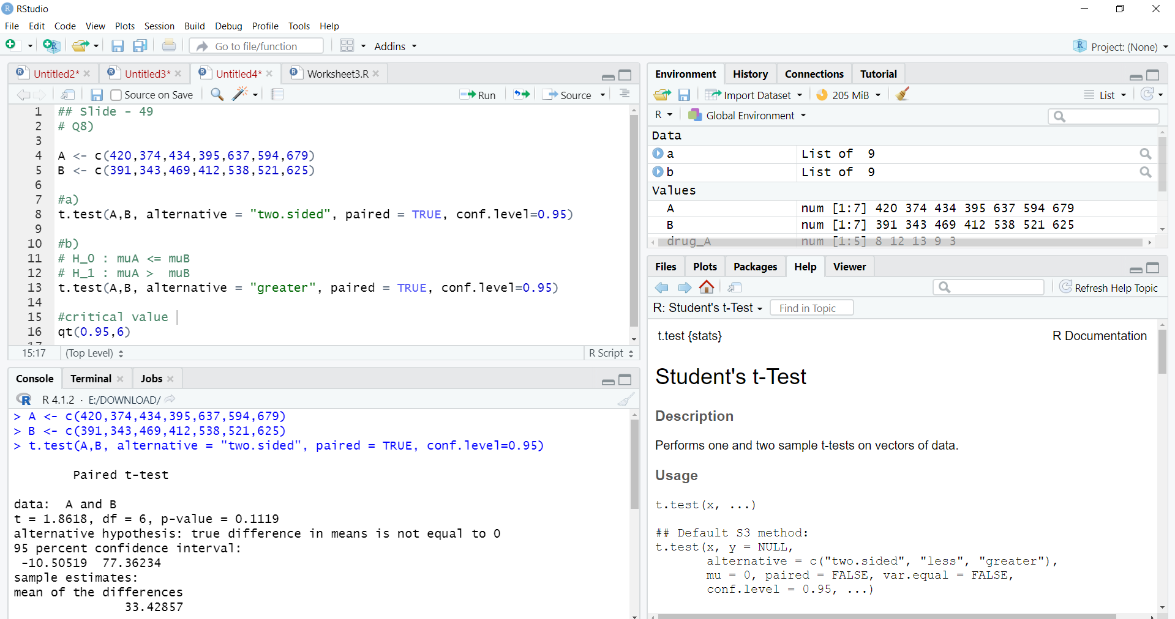
Slide - 49 Question - 8

Slide 63
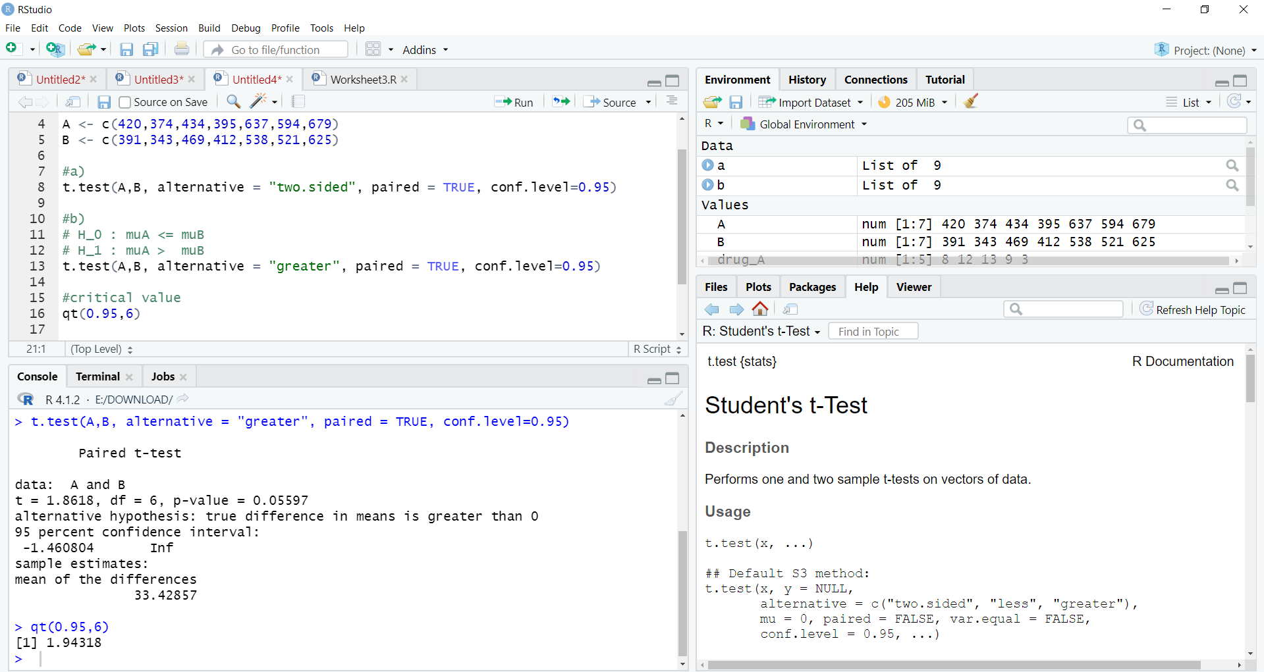
Contd..

Slide 64


Don’t hesitate to contact us if you have any questions about this course’s teaching contents. Also, don’t forget to check out the course page and Microsoft Team folder,
course page Link: https://mayooran1987.github.io/MC3020/
Course page’s QR code
Microsoft Team folder link

